Slide 1




Lecture 8 Ms. Maham Mehr Awan
Achieving Qualities

Slide 2
Achieving Qualities
“The quality requirements specify the responses of the software to get business goals”

Slide 3
Introducing Tactics
The achievement of these qualities relies on fundamental design decisions………...called tactics.
OR
The quality attribute decisions known as tactics…..Collectively known as an architectural strategy.
The control of a quality attribute response.

Slide 4

Introducing Tactics
We represent this relationship in Figure;
A system design consists of a collection of decisions.
Some of these decisions help control the quality attribute responses;
others ensure achievement of system functionality.
Tactics are intended to control responses to stimuli.

Slide 5
Introducing Tactics
Each tactic is a design option for the architect.
For example,
One of the tactics introduces redundancy to increase the availability of a system.
Tactics can refine other tactics.
We identified redundancy as a tactic. As such, it can be refined into redundancy of data (in a database system) or redundancy of computation (in an embedded control system). Both types are also tactics.

Slide 6
Introducing Tactics
We organize the tactics for six quality attribute as a hierarchy,
availability,
modifiability,
performance,
security,
testability,
and usability,
but it is important to understand that each list is intended only to demonstrate some of the tactics, and that any list of tactics is necessarily incomplete.

Slide 7

Quality Attributes and their Tactics

Slide 8
Availability Tactics
Recall the vocabulary for availability.
A failure occurs when the system no longer delivers a service that is consistent with its specification; this failure is observable by the system's users.
A fault (or combination of faults) has the potential to cause a failure.
Recovery or repair is an important aspect of availability.
The tactics will keep faults from becoming failures
or at least bound the effects of the fault and make repair possible.

Slide 9
Availability Tactics
Many of the tactics are available within standard execution environments such as
operating systems,
application servers,
and database management systems.
All approaches to maintaining availability involve;
some type of health monitoring to detect a failure,
some type of recovery when a failure is detected.
And some type of redundancy,

Slide 10
Availability Tactics
Discussion on availability tactics begin with;
fault detection
then consider fault recovery
and finally, briefly, fault prevention.

Slide 11
FAULT DETECTION
Three widely used tactics for recognizing faults are;
ping/echo,
heartbeat,
exceptions.

Slide 12
Ping/echo.
One component issues a ping and expects to receive back an echo, within a predefined time, from the component under scrutiny.
This can be used within a group of components mutually responsible for one task.
For example; It can also be used by clients to ensure that a server object and the communication path are operating within the expected performance bounds.

Slide 13

Ping/echo.
"Ping/echo" fault detectors can be organized in a hierarchy, in which the higher-level fault detectors ping lower-level ones.
This uses less communications bandwidth than a remote fault detector that pings all processes.

Slide 14

Heartbeat (dead man timer).
In this case one component emits a heartbeat message periodically and another component listens for it.
If the heartbeat fails, the originating component is assumed to have failed and a fault correction component is notified.
The heartbeat can also carry data.
For example, an automated teller machine can periodically send the log of the last transaction to a server.
This message not only acts as a heartbeat but also carries data to be processed.

Slide 15
Exceptions.
One method for recognizing faults is to encounter an exception, which is raised when one of the fault classes is recognized.
Fault can be of one of the following types:
Omission
Crash
Timing
Response
The exception handler typically executes in the same process that introduced the exception.
Notes:
- omission. A component fails to respond to an input. - crash. The component repeatedly suffers omission faults. - timing. A component responds but the response is early or late. - response. A component responds with an incorrect value.

Slide 16
FAULT RECOVERY
Fault recovery consists of preparing for recovery and making the system repair.
Some preparation and repair tactics follow.
Voting
Active redundancy (hot restart).
Passive redundancy (warm restart/dual redundancy/triple redundancy).
Spare.

Slide 17
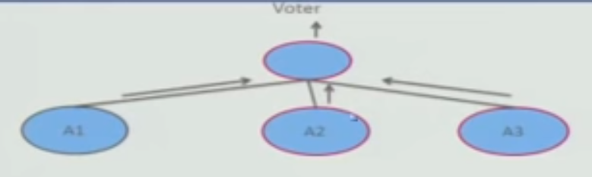
Voting.
Processes running on redundant processors each take equivalent input and compute a simple output value that is sent to a voter.
If the voter detects deviant behavior from a single processor, it fails it.
The voting algorithm can be "majority rules" or "preferred component" or some other algorithm.
This method is used to correct faulty operation of;
algorithms
or failure of a processor
If all of the processors utilize the same algorithms, the redundancy detects only a processor fault.

Slide 18
Voting.
Thus, if the consequence of a failure is extreme, such as potential loss of life, the redundant components can be diverse.
The software for each redundant component is developed by different teams and executes on dissimilar platforms.
Less extreme is to develop a single software component on dissimilar platforms.
Diversity is expensive to develop and maintain and is used only in exceptional circumstances, such as the control on aircraft.
Diversity has no downtime when a failure occurs since the voter continues to operate.
Synchronization among the redundant components is automatic since they are all assumed to be computing on the same set of inputs in parallel.

Slide 19
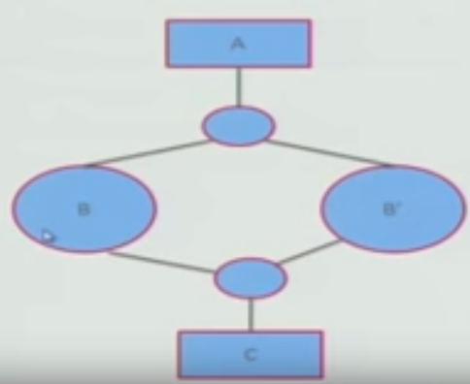
Active redundancy (hot restart).
All redundant components respond to events in parallel.
The response from only one component is used (usually the first to respond), and the rest are discarded.
For example: in a client/server configuration, such as database management systems, where quick responses are necessary even when a fault occurs.
When a fault occurs, the downtime is usually milliseconds……the only time to recover is the switching time.

Slide 20
Active redundancy (hot restart).
Synchronization is performed by ensuring that all messages to any redundant component are sent to all redundant components.
If communication has a possibility of being lost (because of noisy or overloaded communication lines), a reliable transmission protocol can be used to recover.
A reliable transmission protocol requires all recipients to acknowledge receipt together.
If the sender cannot verify that all recipients have received the message,
it will resend the message to those components not acknowledging receipt…….until the sender marks the recipient as out of service.

Slide 21
Passive redundancy (warm restart/dual redundancy).
One component (the primary) responds to events and informs the other components (the standbys) of state updates they must make.
When a fault occurs, the system must first ensure that the backup state is sufficiently fresh before resuming services.
This tactic depends on the standby components taking over reliably.
Forcing switchovers periodically—for example, once a day or once a week—increases the availability of the system.
Some database systems force a switch with storage of every new data item.
In this case, the downtime can usually be limited to seconds.

Slide 22
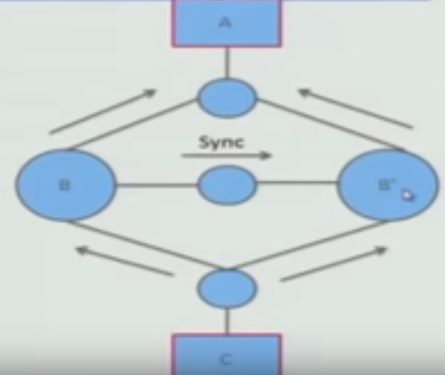
Passive redundancy (warm restart/dual redundancy/).
Synchronization is the responsibility of the primary component, which may use atomic broadcasts to the secondaries to guarantee synchronization.

Slide 23
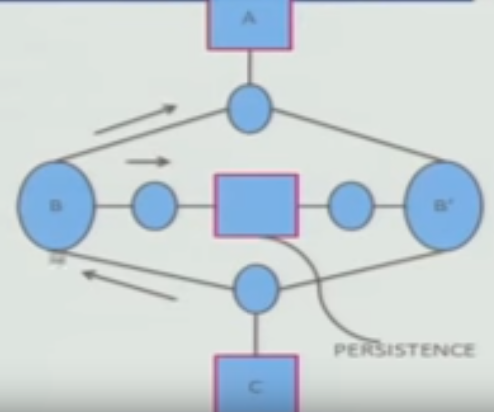
Spare.
A standby spare computing platform is configured to replace many different failed components.
It must be rebooted to the appropriate software configuration and have its state initialized when a failure occurs.
Making a checkpoint of the system state periodically allows for the spare to be set to the appropriate state.
The downtime for this tactic is usually minutes.

Slide 24
Component reintroduction
There are tactics for repair that rely on component reintroduction.
When a redundant component fails, it may be reintroduced after it has been corrected.
Such tactics are
shadow operation,
state resynchronization,
and rollback.

Slide 25
Shadow operation.
A previously failed component may be run in "shadow mode" for a short time
to make sure that it mimics the behavior of the working components before restoring it to service.

Slide 26
State resynchronization.
The passive and active redundancy tactics require the component being restored to have its state upgraded before its return to service.
The updating approach will depend on the downtime that can be sustained,
A single message containing the state is preferable, if possible.

Slide 27
Checkpoint/rollback.
A checkpoint is a recording of a consistent state created either periodically or in response to specific events.
Sometimes a system fails in an unusual manner, with a detectably inconsistent state.
In this case, the system should be restored using a previous checkpoint of a consistent state
and a log of the transactions that occurred was taken.

Slide 28
FAULT PREVENTION
The following are some fault prevention tactics.
Removal from service.
Transactions.
Process monitor.

Slide 29
Removal from service.
This tactic removes a component of the system from operation to undergo some activities to prevent anticipated failures.
One example is rebooting a component to prevent memory leaks from causing a failure.
Removal from service can be automatic or manual, an architectural strategy can be designed to support it.

Slide 30
Transactions.
A transaction is the bundling of several sequential steps such that the entire bundle can be undone at once.
Transactions are used to prevent any data from being affected if one step in a process fails
All or non
and also to prevent collisions among several simultaneous threads accessing the same data.

Slide 31
Process monitor.
Once a fault in a process has been detected,
a monitoring process can delete the nonperforming process
and create a new instance of it, initialized to some appropriate state as in the spare tactic.

Slide 32
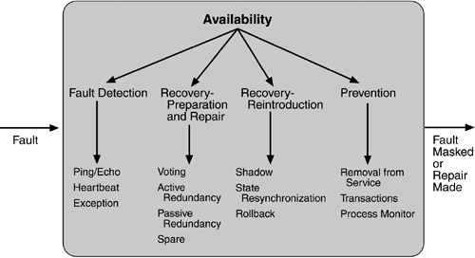
Summary of availability tactics

